Slide 1
Adaptability Level in Online Education

Slide 2
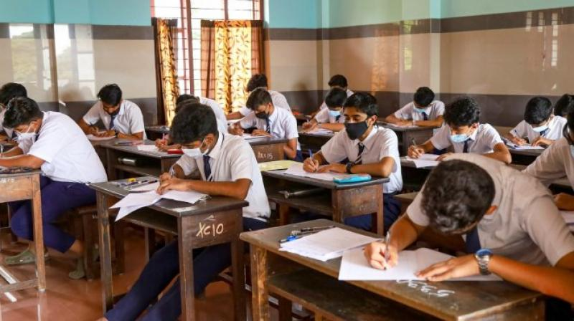
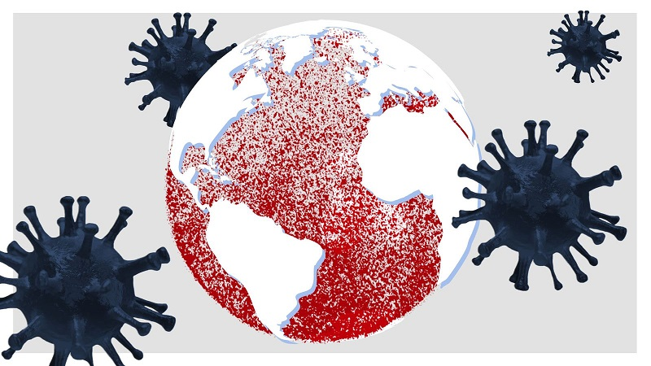

Background
With the COVID-19, students physical patriation has been limited.
Institutions started work on online education.

Slide 3
Objective
Identify level of people adopted to online education based on feature set and build a machine learning model to predict how good a student will grab online education.

Slide 4
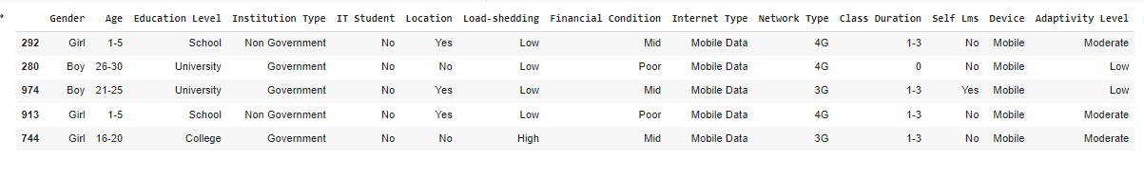
Data set
Uses sample dataset available in Kaggle which based on a survey did in Bangladesh.

Slide 5
Data Inspection
Dataset consist with 1205 rows and 15 columns.
There are no missing data for any of the columns.

Slide 6
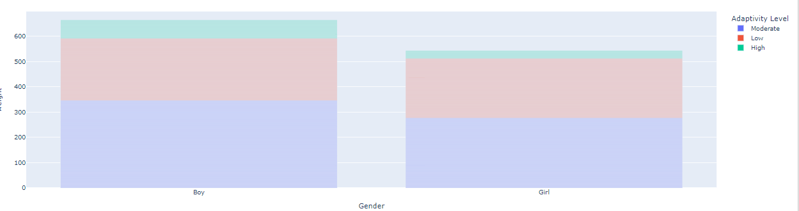
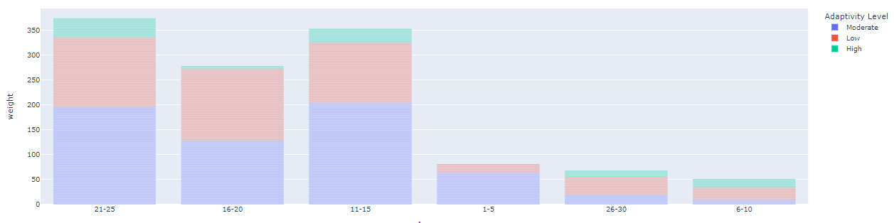
Data Inspection(Cont.)
Does Gender increase adaptivity of the students?
Does Age increase adaptivity of the students?

Slide 7
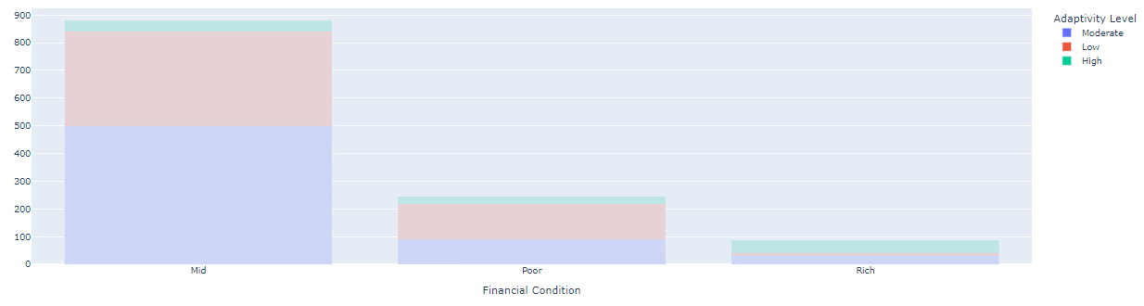
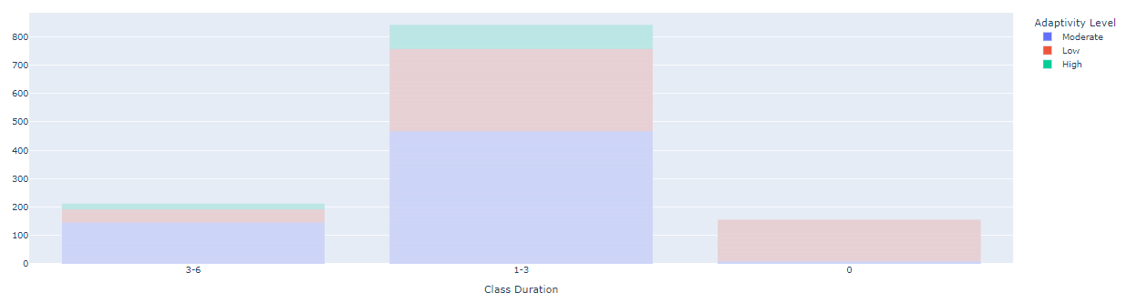
Data Inspection(Cont.)
Does Financial Condition increase adaptivity of the students?
Does Class Duration increase adaptivity of the students?

Slide 8
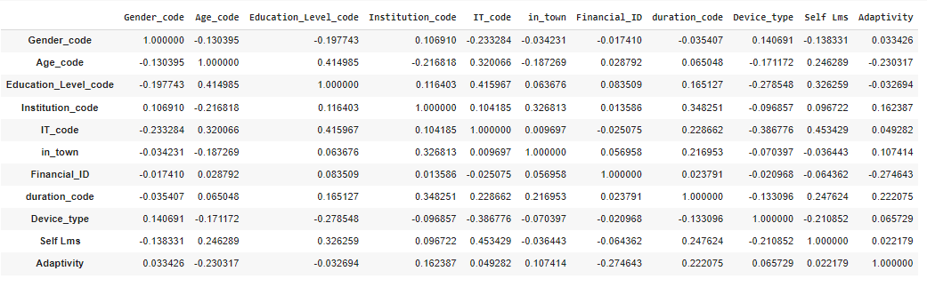
Correlation Matrix

Slide 9

Model Evaluation

